Slide 1
4
INTEGRALS

Slide 2
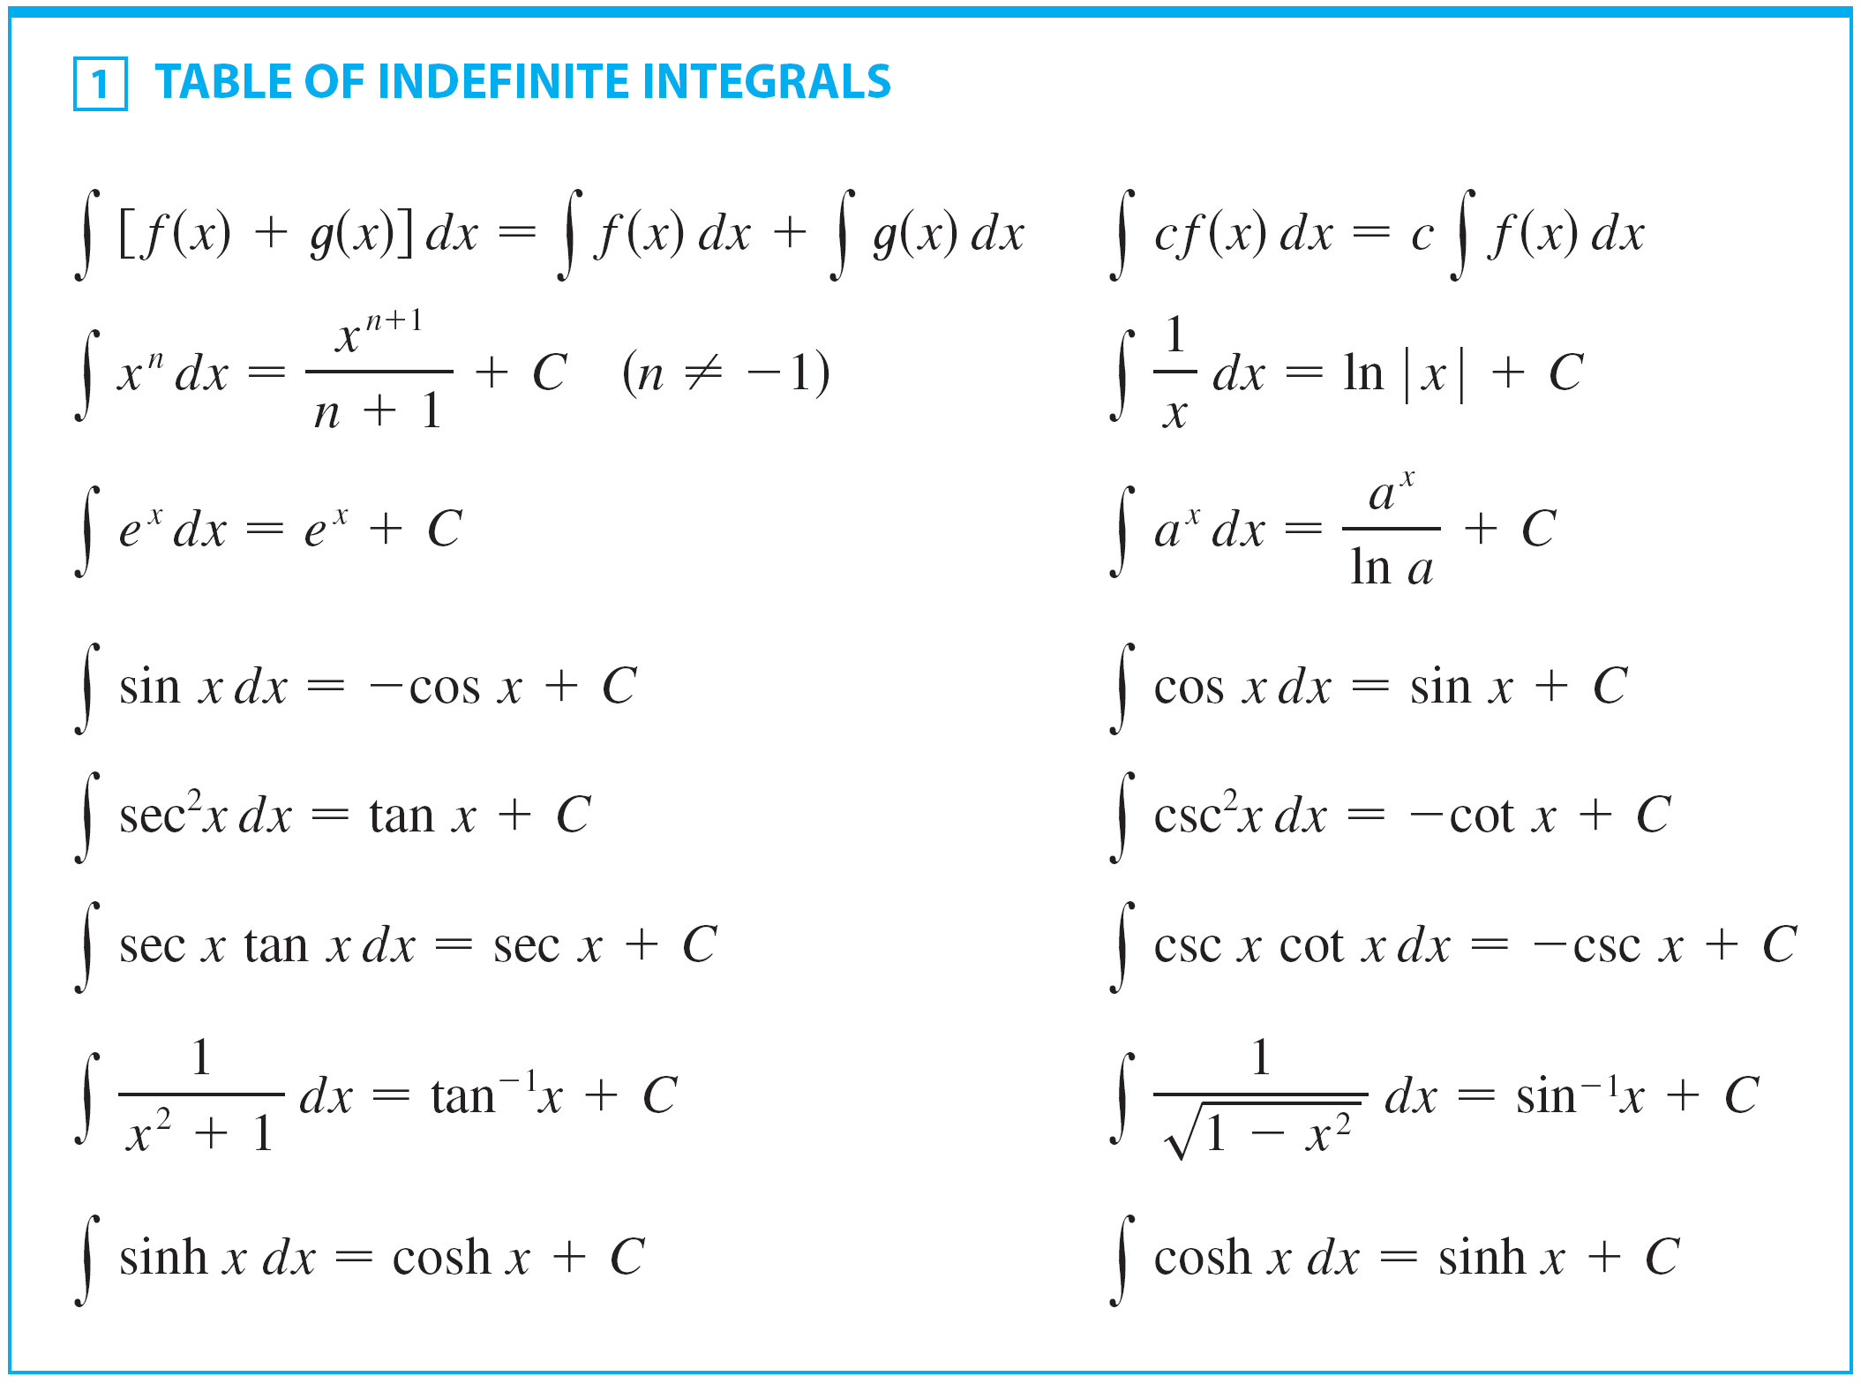
Techniques of integration
Due to the Fundamental Theorem of Calculus (FTC), we can integrate a function if we know an antiderivative, that is, an indefinite integral.
We summarize the
most important
integrals we have
learned so far,
as follows

Slide 3
Techniques of integration
We will develop techniques for using the basic integration formulas, which helps obtain indefinite integrals of more complicated functions.
Substitution Rule
Integration by Parts
Then, we learn methods that are special to particular classes of functions—such as trigonometric functions and rational functions.

Slide 4
Techniques of integration
Integration is not as straightforward as differentiation.
  There are no rules that absolutely guarantee
  obtaining an indefinite integral of a function.
  Therefore, we will discuss a strategy for integration
  in later section.

Slide 5
4.6
Integration by Parts

Slide 6
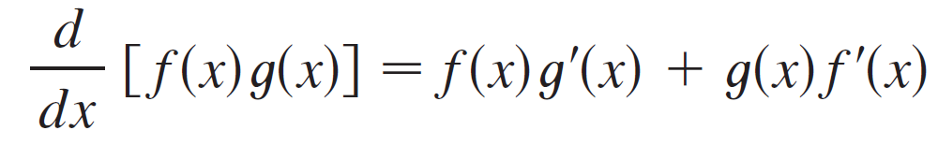
Integration by Parts
Every differentiation rule has a corresponding integration rule.
  For instance, the Substitution Rule for integration corresponds to the Chain Rule for differentiation.
The rule that corresponds to the Product Rule for differentiation is called the rule for integration by parts.
The Product Rule states that if f and g are differentiable functions, then

Slide 7
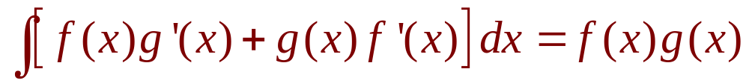
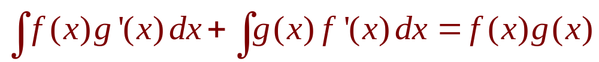
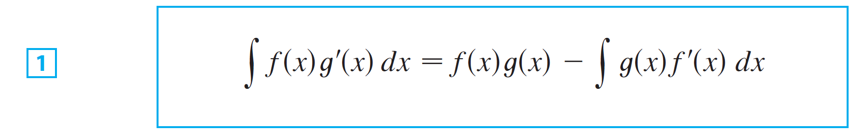
Integration by Parts
In the notation for indefinite integrals this equation becomes
Or
We can rearrange this equation as:
Formula 1 is called the formula for integration by parts.

Slide 8

Integration by Parts
It is perhaps easier to remember in the following notation.
Let u = f (x) and v = g(x).
Then the differentials are
du = f ′(x) dx and dv = g′(x) dx,
so, by the Substitution Rule, the formula for integration by parts becomes

Slide 9
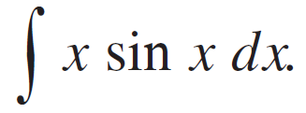
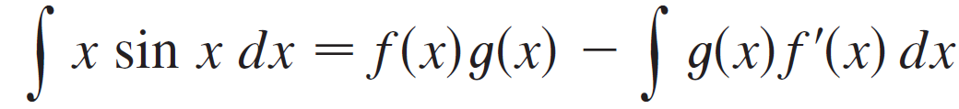
Example 1
Find
Solution:
Using Formula 1
Suppose we choose f (x) = x and g′(x) = sin x.
Then f ′(x) = 1 and g(x) = –cos x.
For g we can choose any antiderivative of g ′.
Thus, using Formula 1, we have

Slide 10
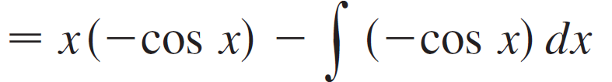
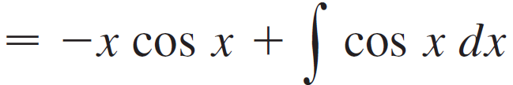

Example 1 – Solution
cont’d
It’s wise to check the answer by differentiating it.
If we do so, we get x sin x, as expected.

Slide 11
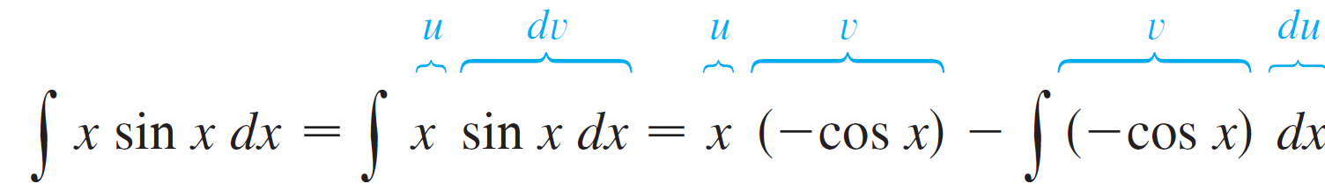
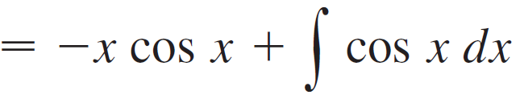
Example 1 – Solution
cont’d
Using Formula 2 Let
Then
and so

Slide 12
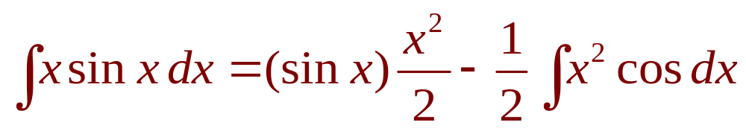
Note
Our aim in using integration by parts is to obtain a simpler integral than the one we started with.
Thus, in Example 1, we started with ∫ x sin x dx and expressed it in terms of the simpler integral ∫ cos x dx.
If we had instead chosen u = sin x and dv = x dx , then du = cos x dx and v = x²/2. So, integration by parts gives:
Although this is true, ∫ x²cos x dx is a more difficult integral than the one we started with.

Slide 13
Note
Hence, when choosing u and dv, we usually try to keep u = f(x) to be a function that becomes simpler when differentiated.
  At least, it should not be more complicated.
  However, make sure that dv = g’(x) dx can be
  readily integrated to give v.

Slide 14
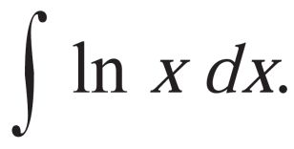

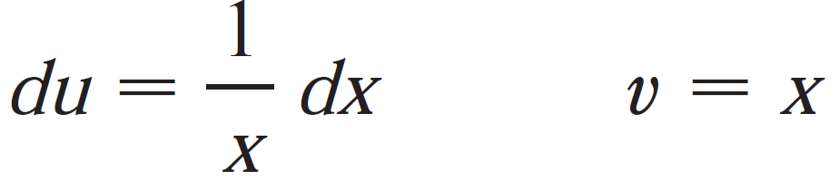
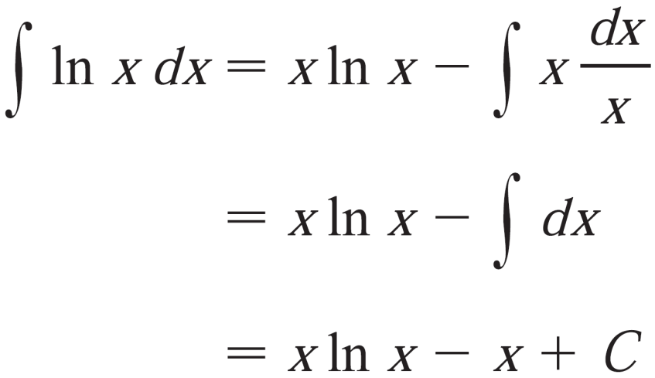
Example 2
Evaluate
Solution:
Here, we don’t have much choice for u and dv.
Let
Then
Integrating by parts, we have
Integration by parts is effective in this example because the derivative of the function f(x) = ln x is simpler than f.

Slide 15
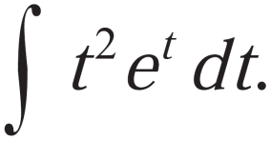
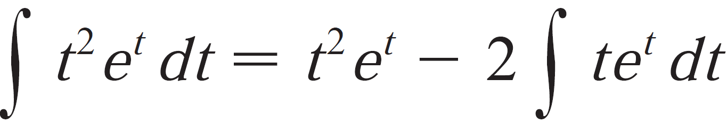
Example 3
Evaluate
Solution:
Notice that t² becomes simpler when differentiated
And, e^{t} is unchanged when differentiated or integrated.
So we choose
Then
Integrating by parts, we have

Slide 16



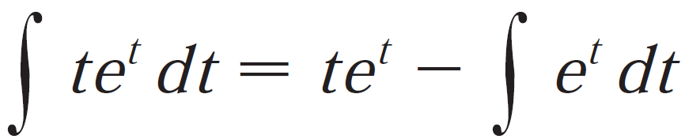

Example 3 – Solution
The integral that we obtained, ∫ te^{t}dt, is simpler than the original integral. However, it is still not obvious.
So, we use integration by parts a second time.
This time, we choose and
Then Integrating by parts, we have

Slide 17
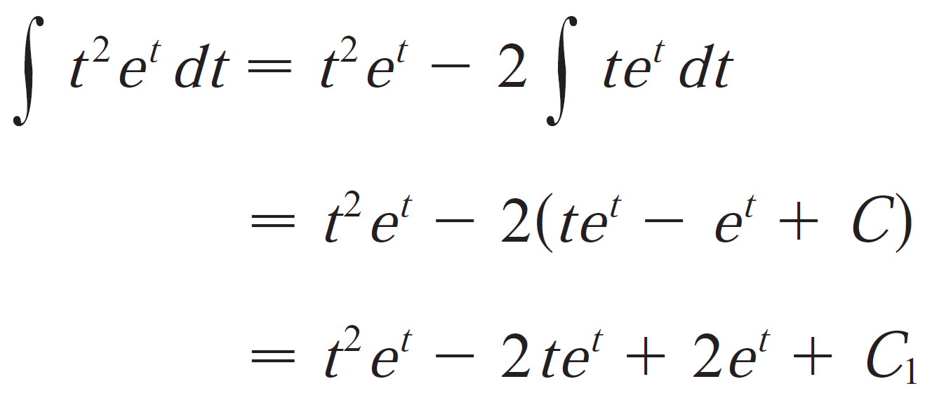
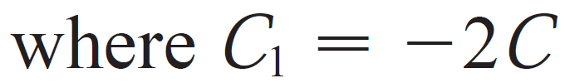
Example 3 – Solution
Putting this in the previous equation, we have

Slide 18
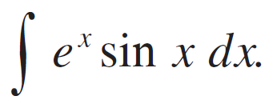
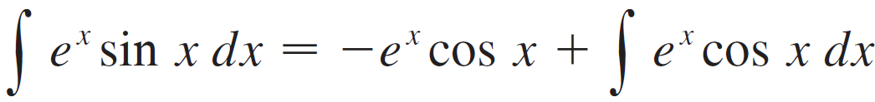

Example 4
Evaluate
Solution:
Neither e^{x} nor sin x becomes simpler when differentiated, but we try choosing u = e^{x} and dv = sin x dx anyway.
Then du = e^{x} dx and v = –cos x, so integration by parts gives

Slide 19


Example 4 – Solution
cont’d
The integral that we have obtained, is no simpler than the original one, but at least it’s no more difficult.
We integrate by parts again.
This time we use u = e^{x} and dv = cos x dx. Then du = e^{x} dx, v = sin x, and

Slide 20


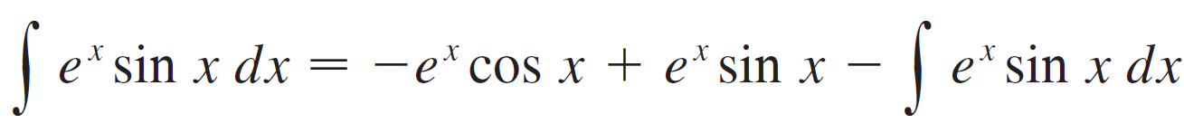
Example 4 – Solution
cont’d
At first glance, it appears as if we have accomplished nothing because we have arrived at which is where we started.
However, if we put the expression for from Equation 5 into Equation 4 we get
This can be regarded as an equation to be solved for the unknown integral.

Slide 21
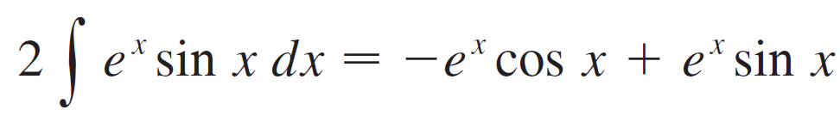
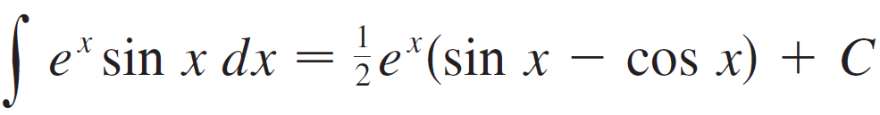
Example 4 – Solution
cont’d
Adding to both sides, we obtain
Dividing by 2 and adding the constant of integration, we get

Slide 22
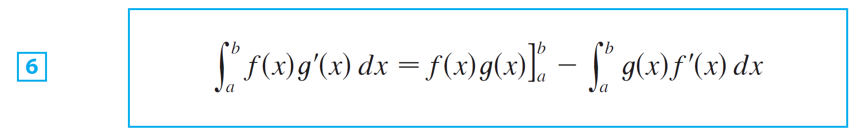
Integration by Parts
If we combine the formula for integration by parts with the Evaluation Theorem, we can evaluate definite integrals by parts.
Evaluating both sides of Formula 1 between a and b, assuming f ′ and g ′ are continuous, and using the Evaluation Theorem, we obtain

Slide 23
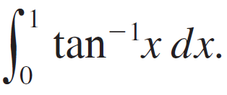
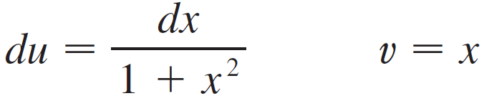
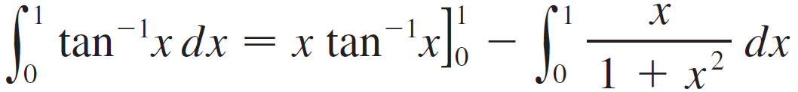
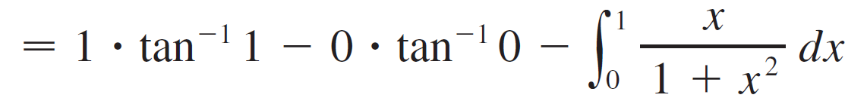
Example 5
Calculate
Solution:
Let
Then
So Formula 6 gives

Slide 24
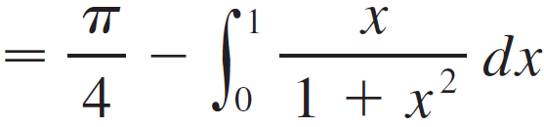
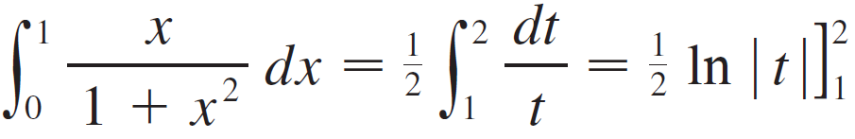

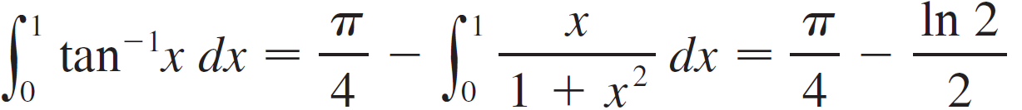
Example 5 – Solution
cont’d
To evaluate this integral we use the substitution t = 1 + x² (since u has another meaning in this example).
Then dt = 2x dx, so x dx = dt. When x = 0, t = 1; when
x = 1, t = 2; so
Therefore

Slide 25
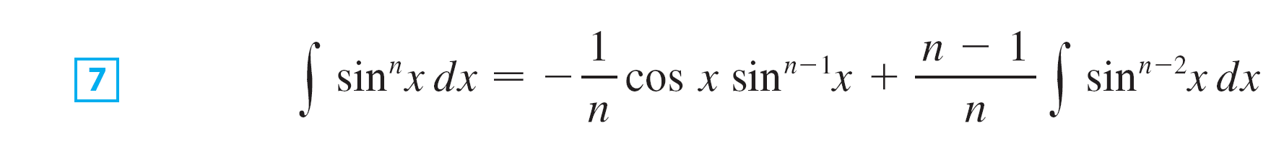



Integration by Parts
Prove the following reduction formula using Integration by parts.
Reduction Formula:
where n ≥ 2 is an integer.
The reduction formula 7 is useful because by using it repeatedly we could eventually express in terms of (if n is odd) or (if n is even).

Slide 26
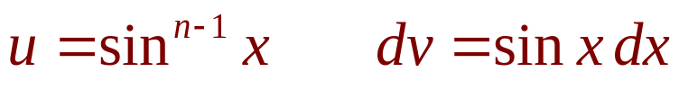
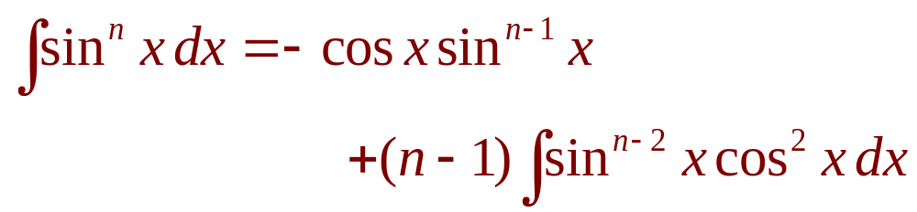
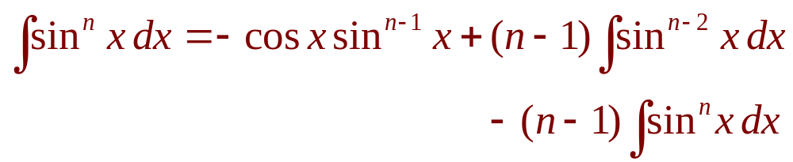
Integration by Parts
Let
Then,
So, integration by parts gives:
Since cos²x = 1 – sin²x, we have:

Slide 27
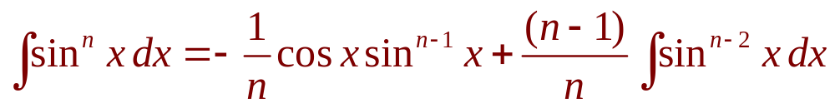
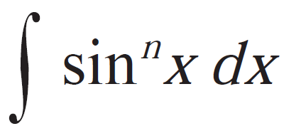
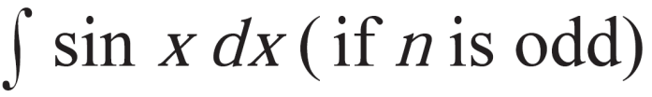
Integration by Parts
Thus, we have:
Or
The reduction formula (7) is useful. By using it repeatedly, we could express in terms of:

